Slide 1
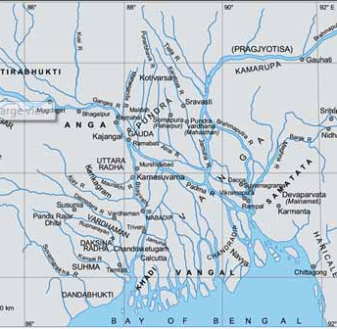
Origin of Bengal politics, land, and people
This lecture discusses the origin of the name ‘Bangladesh’, the people inhabiting this country, and also of the languages with special emphasis on Bangla, the mother language of the Bangali race.

Slide 2
1. Origin of the name
“Bangladesh is a new state in an ancient land”…
Etymologically, the word Bangladesh is derived from the cognate “Banga" which was first mentioned in the Hindu scripture, between 500 BC and 500 AD).

Slide 3
According to linguists, Bengal was first colonized by Prince Vanga, the son of King Bali and Queen Sudeshna of the Lunar dynasty.

Slide 4
One school of linguists maintain that the word "Vanga" is derived from the Tibetan word "Bans" which implies "wet and moist". According to this interpretation, Bangladesh literally refers to a wetland.
(A Land of Water and Silt, Van Schendel, 2009)

Slide 5
Another school is of the opinion that the term "Vangla" is derived from Bodo (aborigines of Assam) words "Bang" and "la" which connote "wide plains."

Slide 6
Bangladesh means "Land of Bengal" or "Country of Bengal"
Rabindranath Tagore first used the term ‘Bangladesh’ in literature. He called entire Bengal as Bangla Desh
Bangabandhu Sheikh Mujibur Rahman took the term ‘Bangladesh’ from Rabindranath Tagore literature and poems.
On December 5, 1969, Bangabandhu made a declaration naming the then East Pakistan as “Bangladesh” at a discussion

Slide 7
2. Origin of land and politics!
The Bengal polities appeared to have been relatively ‘Small, Transient: A situation of ‘matsyanyayam’- ‘fish-eat-fish’

Slide 8


Slide 9
‘Judgements of the fishes’: big fish devoured small fish,
Political fragmentation- ‘Every Ksatriya, Brahmin, and merchant was a king at own house…and there was no king rulling over the country’

Slide 10
The political condition of Bengal after the death of Sasanka was one of disorder and confusion….before the rise of the Palas (750-850) has been described as matsyanyayam (matsyanyayam).

Slide 11
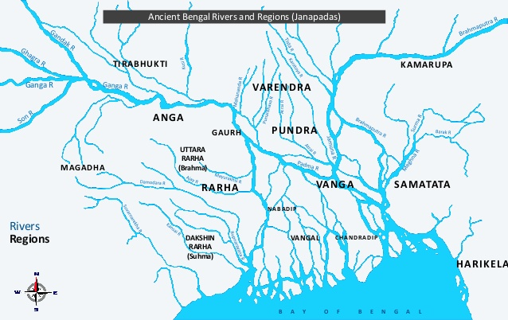
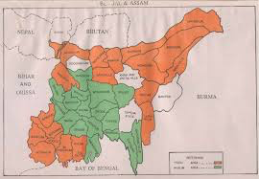
Ancient Bengal

Slide 12
Ancient Janapada (9-22) and Mahajanapadas (16)
Banga (Central Bangladesh)
Harikela (North-East Bangladesh)
Pundra Vardhana (Northern Bangladesh)
Gauda (parts of West Bengal and Bangladesh)
Vangala (Southern Bangladesh)
Chandradwipa (Southern Bangladesh), and
Samatata (Eastern Bangladesh)

Slide 13
Most of the Janapadas were integrated and united into ‘the land of Bangladesh’

Slide 14
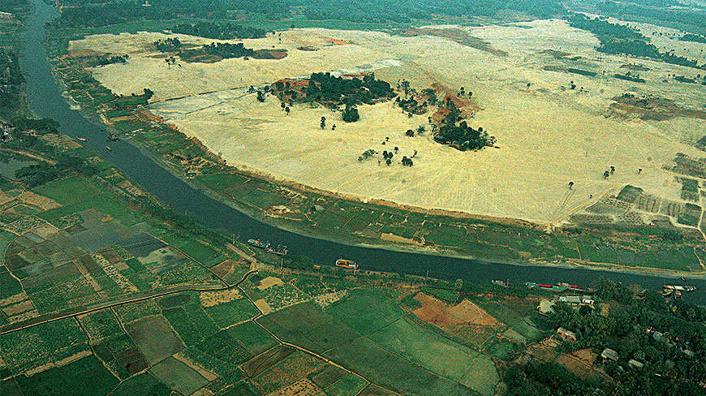
Gangaridai- one of the Ancient Mahajapada with the capital at Wari-Bateshwar (in Bangladesh)

Slide 15
Medieval Bengal
The Islamic conquest of Bengal began with the capture of Gauda from the Sena dynasty in 1204. Led by Bakhtiar Khilji, an army of several thousand horsemen from the Delhi Sultanate overwhelmed Bengali Hindu forces.
After victory, the Delhi Sultanate maintained a strong vigil on Bengal…

Slide 16
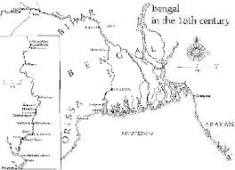

Slide 17
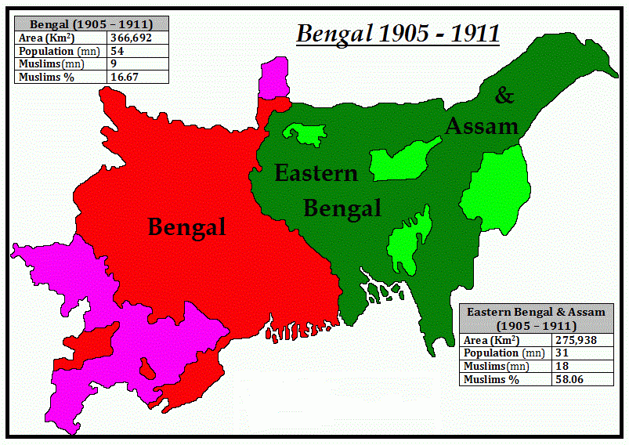

Slide 18
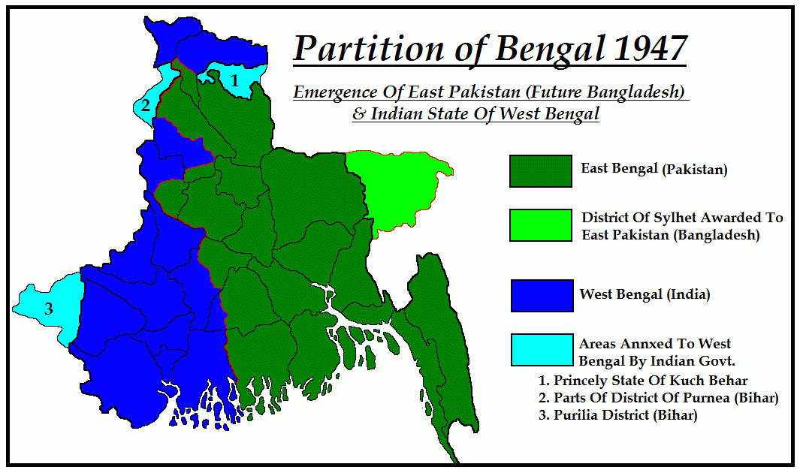

Slide 19
3. People: Race & Culture
The ‘Bengali’ people are historically of diverse origin, having emerged from the confluence of various communities that entered the region over the course of many centuries...
The Vedda peoples were the earliest group to settle in the area, followed by peoples from the Mediterranean and neighbouring areas, particularly Indo-European
During the 8th Century, persons of Arab, Persian, and Turkish origin moved in large numbers to the subcontinent.
By the beginning of the 13th century, they had entered what is now Bangladesh.

Slide 20
Combining Dravidian, Indo-Aryan, Mongol/Mughul, Arab, Persian, Turkic, and West European cultures.
Dravidian culture - ancestor and nature worship, grains staple food, architecturally inclined….
Aryan Culture - fire worship, rice staple food, religiously inclined, Vedic-sanskrit….

Slide 21
Non-Bengali—the largest are the Chakma, the Marma (Magh or Mogh), the Tripura (Tipra), and the Mro, the Khomoi (Kumi), the Kuki, and the Mizo (formerly called Lushai) are among the smaller groups…

